Slide 1
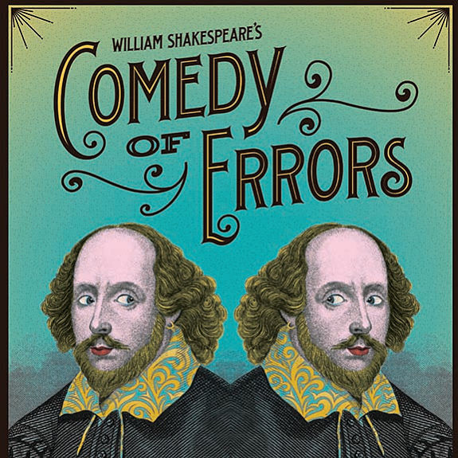
Backgammon
Notes:
Introduce Self
- Chess to BG
- Gill
- Independent
- Author
- Day Job
Lawson – when a man reaches 50……….
Plagiarism/research
Show DVD

Slide 2
A Brief Conversation
Neil Kazross: I was shocked when I won the LA consolation in June and played nicely under 3 and my incredible opponent, Hideaki Ueda, played at half my PR!
Chris Bray: It is just possible that the age of the dinosaurs is passing!
Notes:
Tribal doctors
- foretell future
- better to wager with others
These are 5,000 years old
Note 4,500 years before cards (after the printing press)

Slide 3
“There is more to learn, but my problem is more
about execution than learning.
It is dangerous if you cannot play very well, but
it is a lot worse if you do not know that you cannot
play very well. ”
Malcolm Davis (2011)

Slide 4
“Good checker play will never compensate for
serious errors of judgement in doubling.”
Paul Magriel – Backgammon (1976)

Slide 5
“Given the same amount of intelligence, timidity will do a thousand times more damage than audacity”
- Karl von Clausewitz

Slide 6
“I will often redouble what I am pretty sure is not
a redouble on the chance that my opponent will
pass. This is big key to winning matches about
which the bots are clueless.”
Nack Ballard (2004)

Slide 7
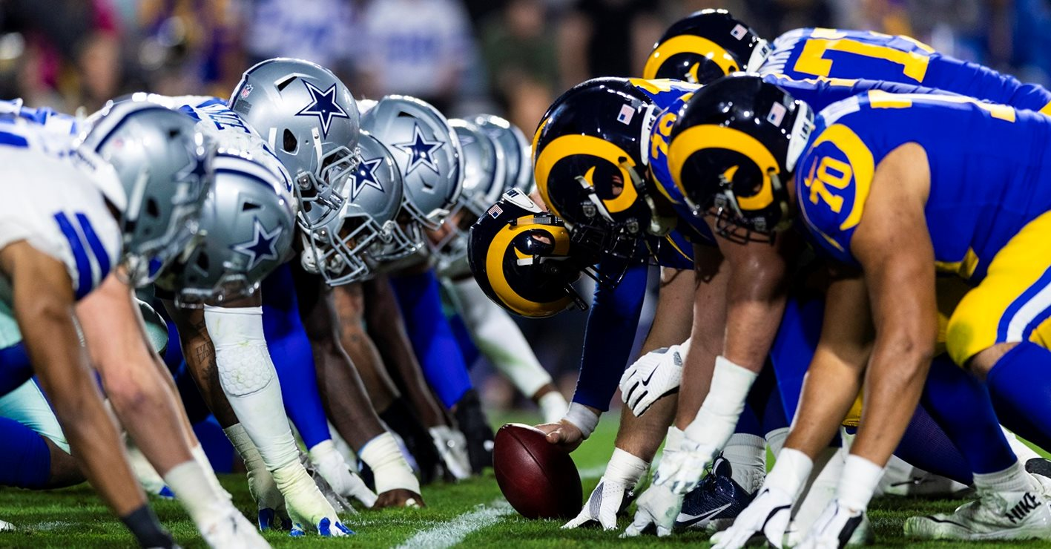
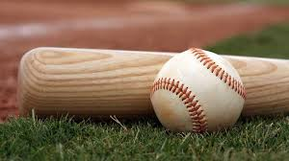
American Football vs Baseball

Slide 8
Error Classification
Complete Oversight
Misjudgements
Strategic Errors
Emotional Errors
Time Errors
Machine Errors

Slide 9
Oversight
Definition: An unintentional failure to notice or do something

Slide 10
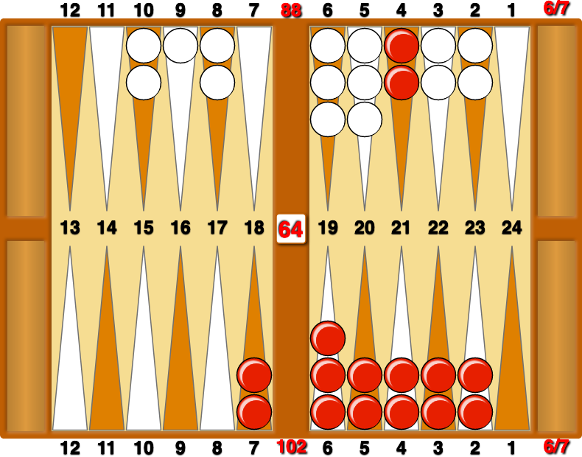
Classic Oversight
Match Play. 6-6 to 7. Red on Roll.

Slide 11
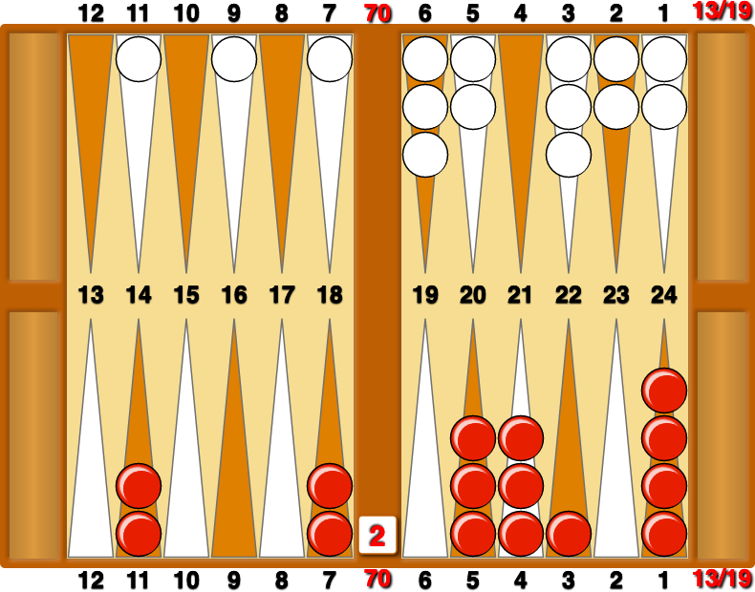
Bangalore Breakdown
Match Play. 13-13 to 19. Red on Roll. Cube Action?
Correct Play: No Double/take

Slide 12
Misjudgements

Slide 13
Misjudgement
Definition: to judge, estimate, or value wrongly or unjustly

Slide 14
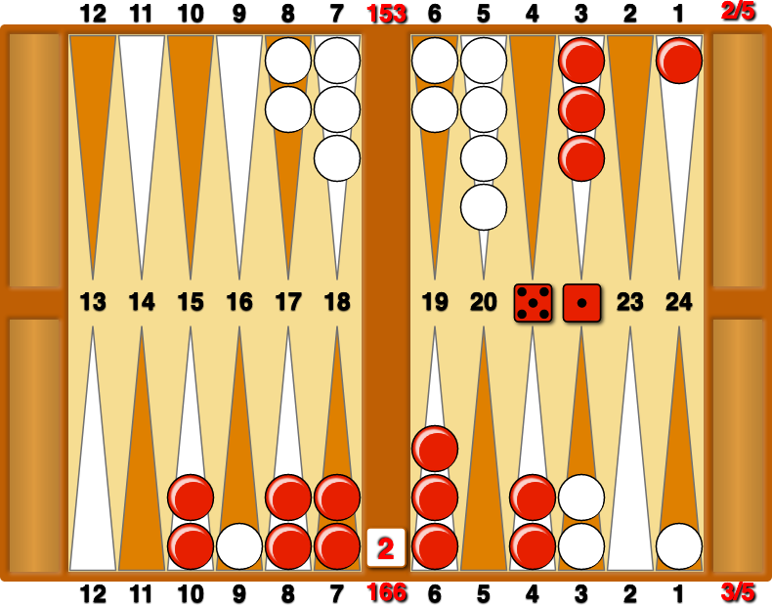
London League
Match Play. Red leads 3-2 to 5. Red on Roll
Correct Play: 10/5, 6/5

Slide 15
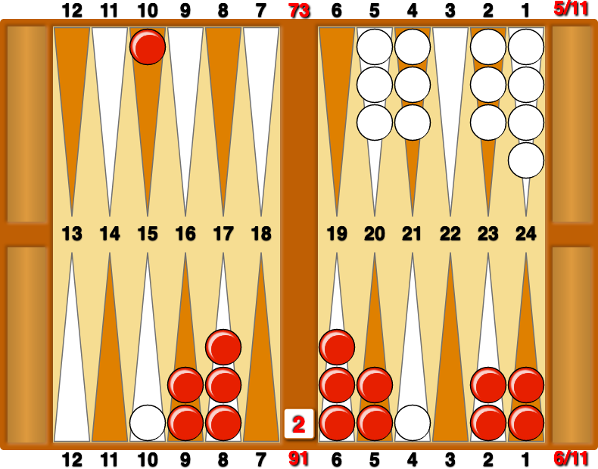
Cube Problem
Match Play. 6-5 to 11. Cube Action?
Correct Play: Redouble/take or pass

Slide 16
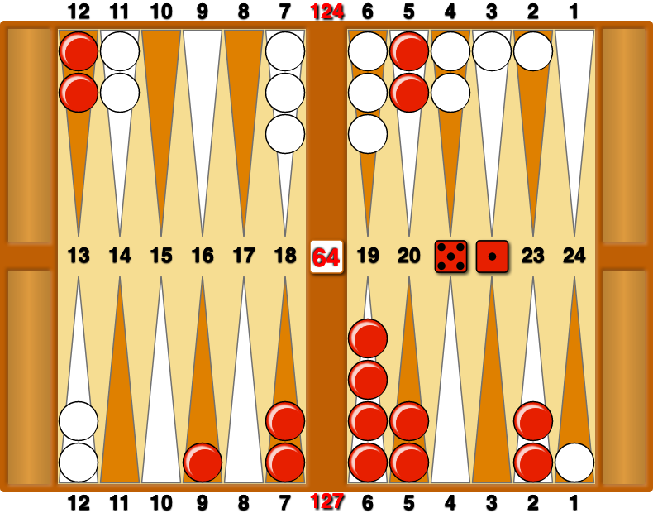
USBGF Problem
Money Play. How should Red play 51?
Correct Play: 13/8, 6/5

Slide 17
Knowledge Errors

Slide 18
Ignorance
Definition: lack of knowledge or information

Slide 19
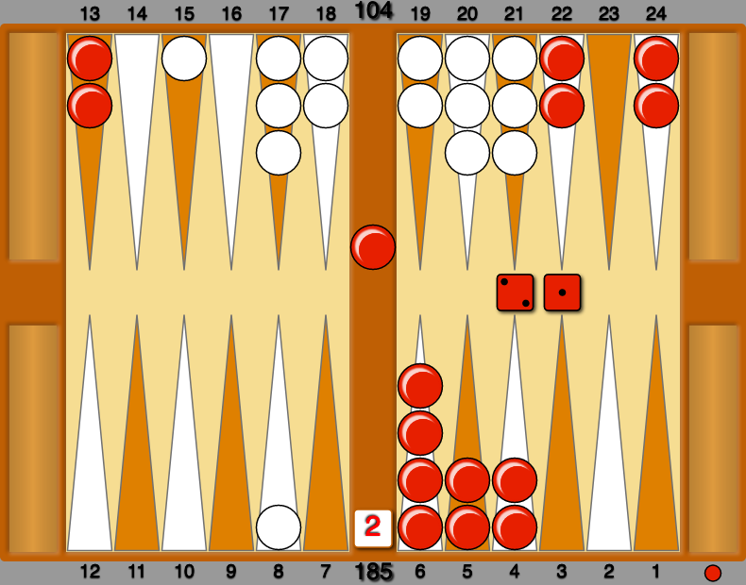
Back Game Error
Money Play. How should Red play 21?
Correct Play: bar/23, 24/23

Slide 20
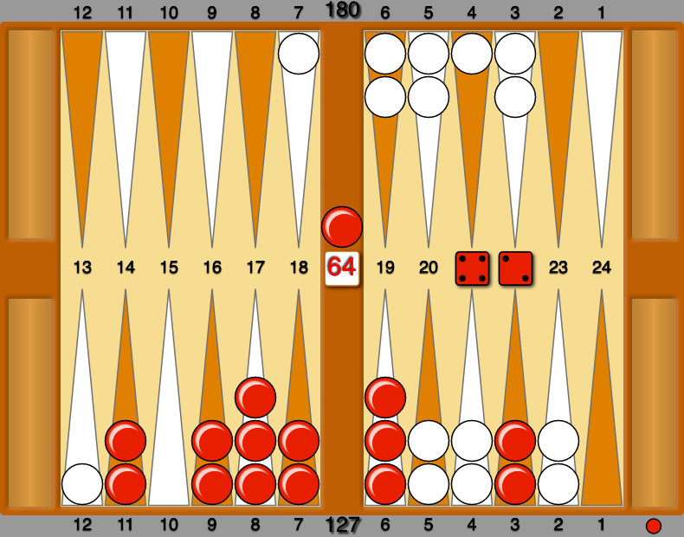
Back Game Error (2)
Money Play. How should Red play 42?
Correct Play: bar/21*, 3/1

Slide 21
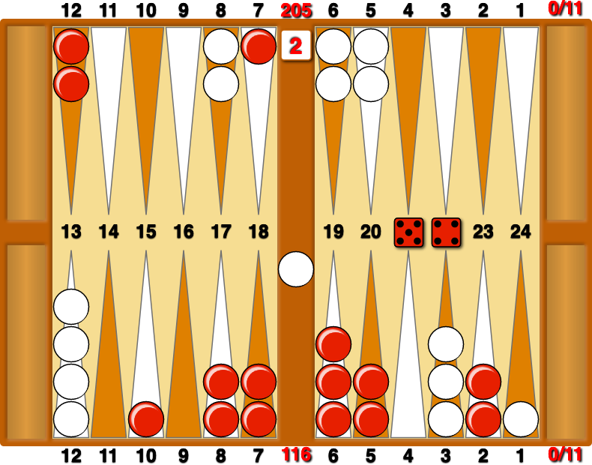
Middle Game Blunder
Match Play. 0-0 to 11. How should Red play 54?
Correct Play: Any move that hits on the 1-pt!

Slide 22
Emotional Errors

Slide 23
Emotion
Definition: a strong feeling deriving from one's circumstances, mood, or relationships with others

Slide 24
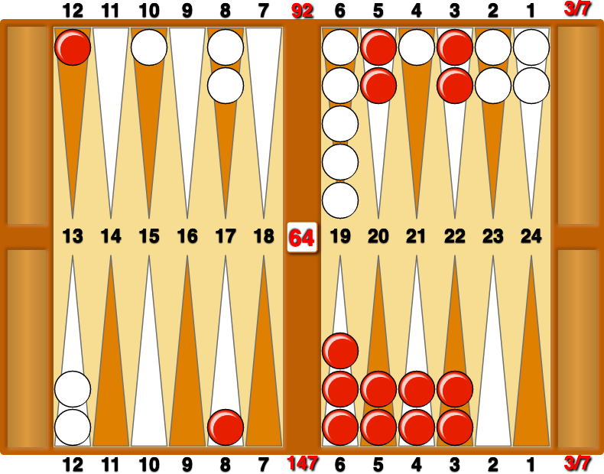
UK vs Belgium
Match Play. 3-3 to 7. Cube Action?
Correct Play: Double/Take

Slide 25
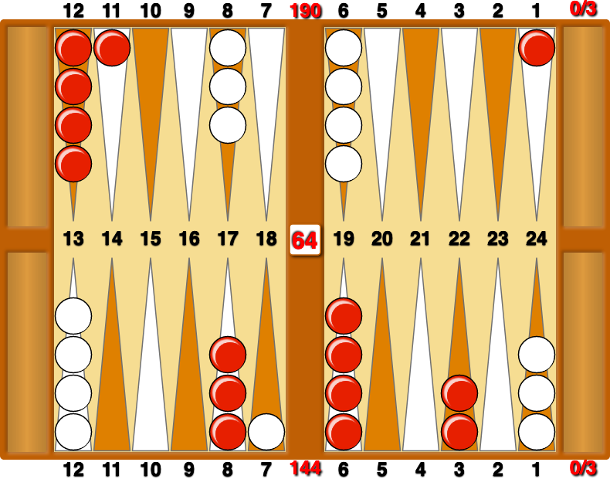
UK vs Belgium
Match Play. 0-0 to 3. Cube Action?
Correct Play: Double/no double/Take

Slide 26
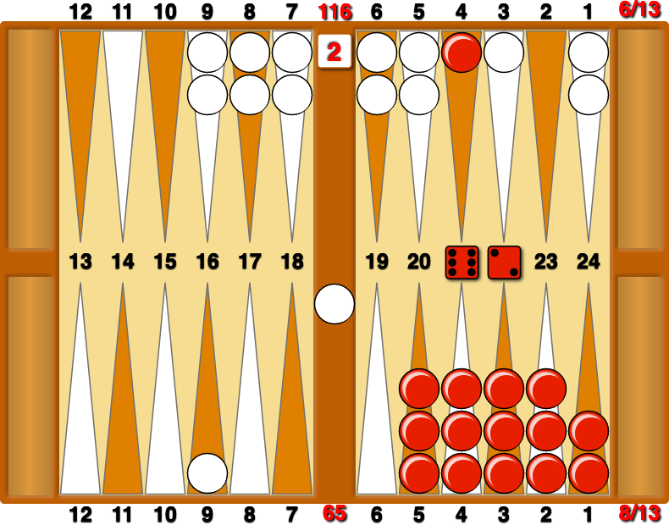
UK vs Germany (1)
Match Play. Red leads 8-6 to 13. Red to play 62?
Correct Play: 21/13 or 21/15, 3/1

Slide 27
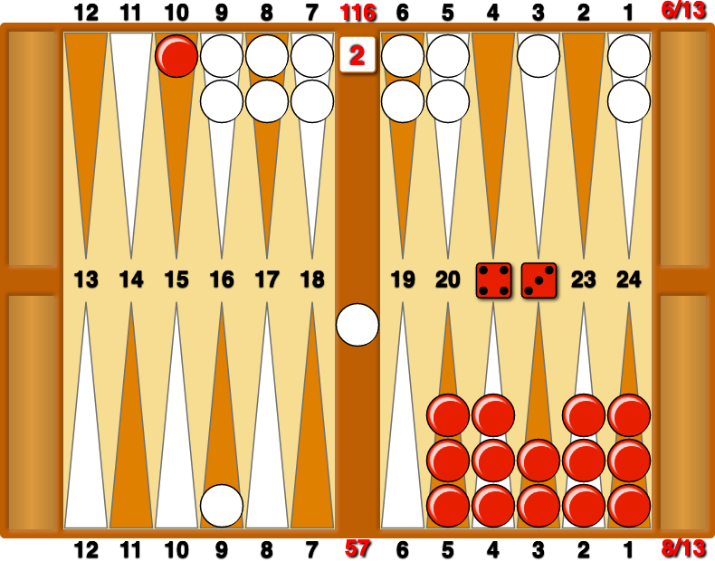
UK vs Germany (2)
Match Play. Red leads 8-6 to 13. Red to play 43?
Correct Play: 15/8

Slide 28
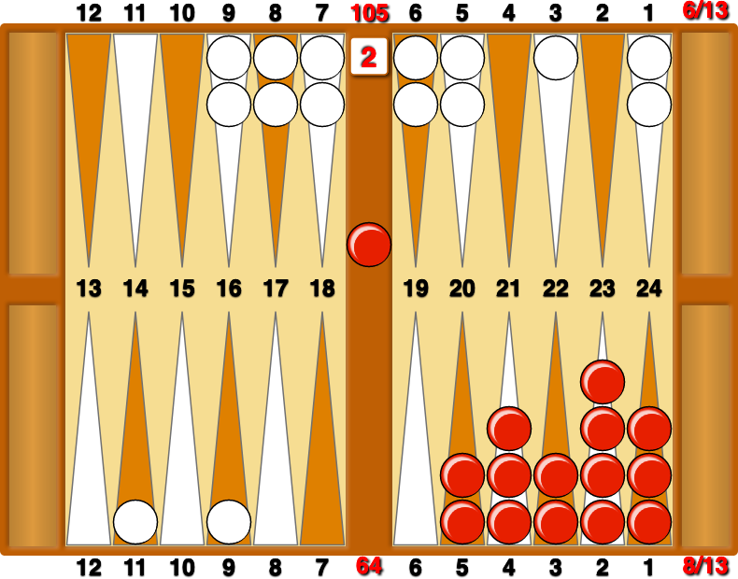
UK vs Germany (3)
Match Play. Red leads 8-6 to 13. White on Roll. Cube Action?
Correct Play: No redouble/take

Slide 29
Time Errors

Slide 30
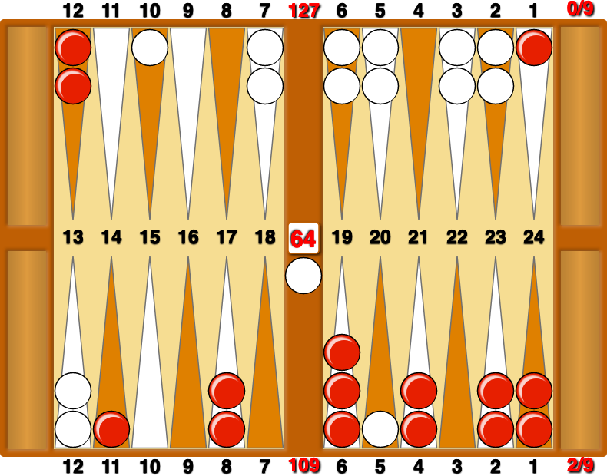
UK vs Belgium
Match Play. Red leads 2-0 to 7. Cube Action?
Correct Play: Double/take

Slide 31
Machine Errors

Slide 32
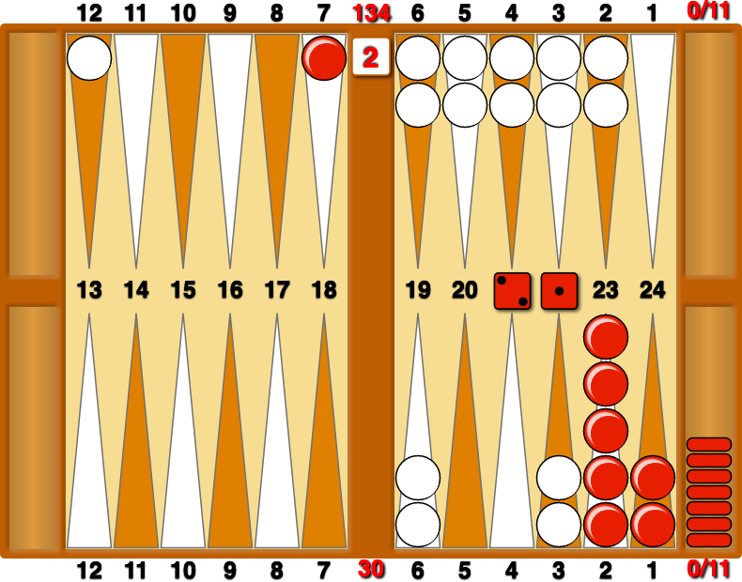
UK vs Germany
Match Play. 0-0 to 11. How should Red play 21?
Correct Play: To be discussed!

Slide 33
Error Correction
Complete Oversight ✔︎
Misjudgements ✖︎
Knowledge Errors ✔︎ *
Emotional Errors ✔︎
Time Errors ✔︎
Machine Errors ✔
* With a lot of hard work!

Slide 34
Improving Your Play

Slide 35
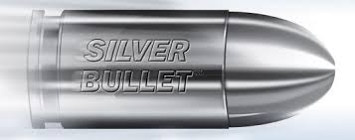
XXX

Slide 36
Methods of Improvement
Learning just by playing is long and arduous
Read at least one book every six months
Study online matches
Take lessons
Play different people
Play chouettes
Play online
Play tournaments/matches
Play (and analyse) using Extreme Gammon (XG) and XG Mobile in Tutor Mode

Slide 37
Conclusion
Like the original this one is set to run and run
and will still be playing to packed houses in
another 400 years!!

Slide 38
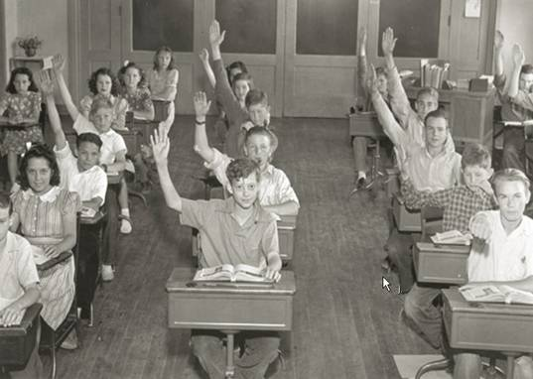
Any Questions?
38
Notes:
38

